Slide 1





Kate McCallister
Taxonomy
Skates
Vs.
Rays
Physical
Characteristics
Skates and Rays
Where they live
References
Exciting
Facts
All sources are cited by number that corresponds to source on reference page.

Slide 2
Taxonomy
Cladoselache
Kingdom: Animalia
Phylum: Chordata
SubPhylum: Vertebrata
Class: Chondricthyes
Subclass: Elasmobranchii
Superorder: Batoidea (Rajomorphii)
78 genera in 19 families and 5 orders
555-573 species
Xenacanthus
Ctenacanthus
Elasmobranchii
Hybodus
Galeomorphs
Chondrichthyes
Squaliformes
Euselachii
Neoselachii
Squalea
Batoidea
Chimaeras
Holocephali
(6)
(10)

Slide 3
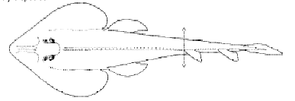
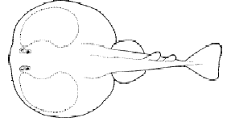





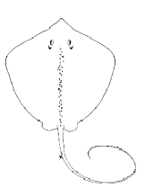
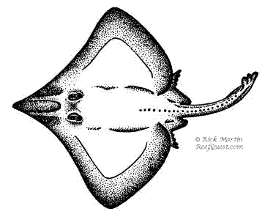
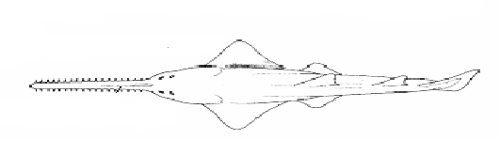
Orders
*
Torpediniformes
Rhinobatiformes
*
Rajiformes
Myliobatiformes
*
Pristiformes
(5)
*

Slide 4
Pristiformes
Sawfishes
Shark like body
Saw-like elongate snout
Grow up to 7.3 meters
Found in shallow marine waters and estuaries
*
*
(6)
*

Slide 5
Rhinobatiformes
Guitarfish
2 dorsal fins
Grow up to 3 meters (5)
Shark like body with expanded pectoral fins fused to head and trunk
Found from intertidal to 366meter (6)
*

Slide 6
Torpediniformes
2 dorsal fins
Electric organ(6,12)
Greatly expanded pectoral fins fused to head and trunk
Shark like tail
Grow up to 1.3 m
Found from shallow water to 200m
*
*
*

Slide 7
Rajiformes
Skates
Pelvic fin divided into two lobes(6)
2 dorsal fins
257 to 275 species (5)

Slide 8
Myliobatiformes
Flattened body with greatly expanded pectoral fins fused to head and trunk
Slender tail (often with spine)(4)
Single dorsal fin
No caudal fin
Singrays, eaglerays, and mantarays

Slide 9
Physical Characteristics
Dorsoventrally flattened body
Eyes and Spiracles on top of head
Five pairs of ventrally located gill slits
Expanded pectoral fins attached to head
Ventrally located mouth
Cartilage skeleton
Some have electroreceptive organs
Range in size from 30 cm to 6.1 meters (7)
(10)

Slide 10
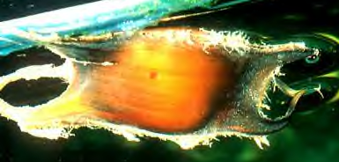
Differences between Skates and Rays
Skates
Pelvic fins divided into two lobes
Stocky tail with no spine
Normally drab colored (brown, grey)
Normally inhabit deep water
Oviparous
(Produce egg cases )
Rays
Pelvic fins with one lobe
Slender whip-like tail usually with stinging spine
Rays usually blotched or spotted
Usually occur in shallow waters
Uterine viviparity
(fetus gets nourishment from secretions from uterus or pseudo-placenta)
(9)
(5)

Slide 11
Where they live
Skates and Rays Can be found in (7):
  All Oceans (from cold temperate to warm tropical zones)
  Estuaries
  Fresh water streams
  Lagoons
  Lakes
  From shallow offshore waters to depths of 9,840 ft.(5)
Skates usually found in deep waters
Rays most abundant near and in-shore tropical waters
Most are benthic (due to lack of swim bladder)(3)

Slide 12
Exciting Facts
Skates and rays evolved in the Jurassic period about 150 million years ago (4)
Manta rays can jump 20-30 yards out of the water (2)
Torpedo rays kill prey by shocking it with 1,000 watt jolts of electricity (2)
Have very efficient chemoreception- they can detect concentrations as low as 1 part per 10 billion.(8)

Slide 13
References
1)Electroreception in Elamobranchs (Sharks, Skates, and Rays). http://umbc7.umbc.edu/~cole/electro.htm
2)The Chondricthyans. http://www.oceansonline.com/fishes2.htm
3)Chesapeake Bay Program-Animals and Plants. http://www.chesapeakebay.net/info.cownose_ray.cfm
4)Sharks, Skates and Rays and Ratfishes. http://gwis2.circ.gwu.edu/~atkins/newwebpages/Chondrichthyes/SHARK22.html
5)Shark Profiles by Rick Martin and Reef Quest Expeditions. http://www.reefquest.com
6)Rays. http://www.enchantedlearning.com/subjects/sharks/rays
7)Bizzy Divers. http://www.bizzydivers.co.uk/magazine/identification_rays.asp
8) General vertebrate Zoology. http://biology.unm.edu/Biology/fishes/people/gvz/lecture6.htm
9) Acquario Comunal Grosseto rajiformes sito ideato. www.gol..grosseto.it/acquario/rajiformes.htm
10) Liem,Bemis,Walker and Grande. 2001.Functional Anatomy of the Vertebrates:An evolutionary perspective 3rd edition.Harcourt College Publishers

